Slide 1
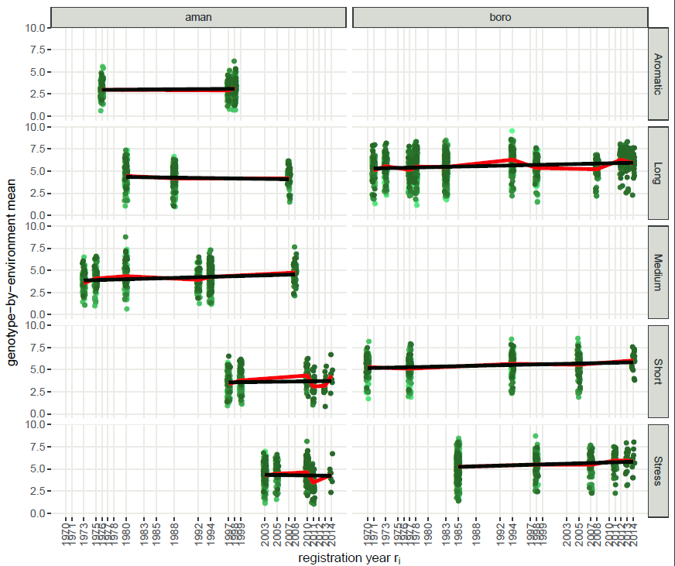
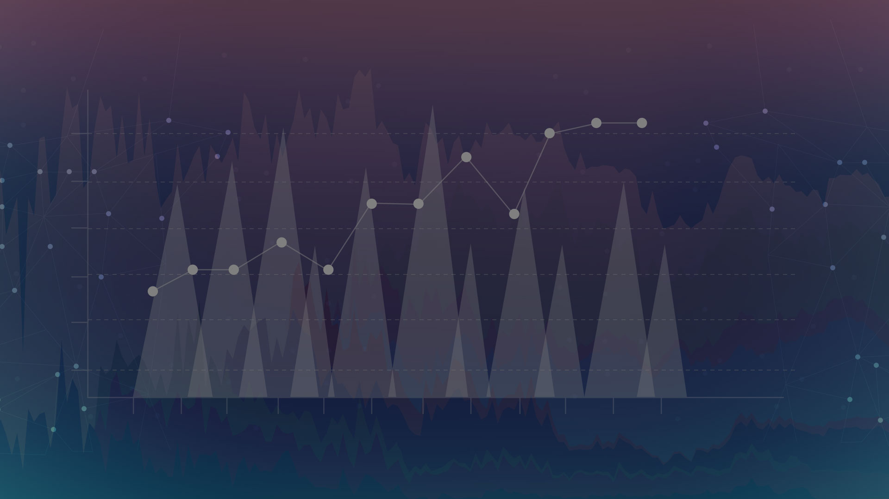
Implementation of genetic trend assessment using the BRRI data

Slide 2

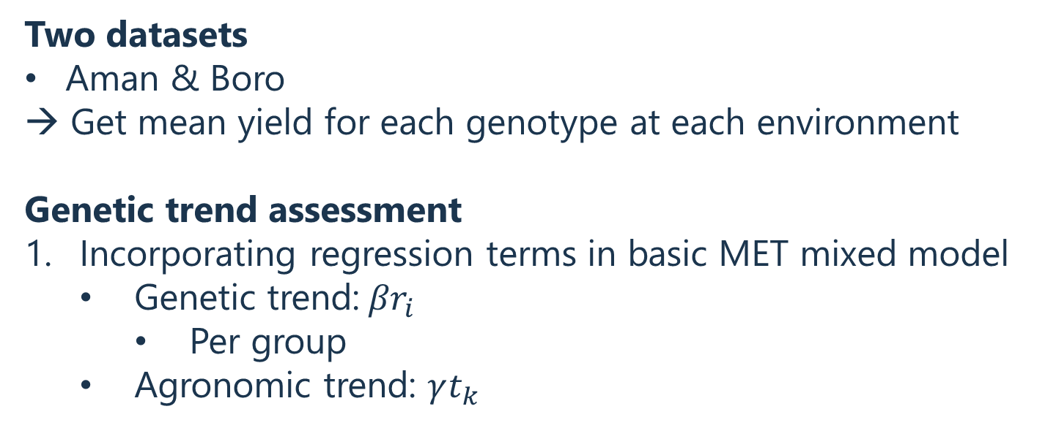
Overview
Two datasets
Aman & Boro
→ Get mean yield for each genotype at each environment
Genetic trend assessment
Incorporating regression terms in basic MET mixed model
Genetic trend:${βr}_{i}$
Per group
Agronomic trend: $γt_{k}$

Slide 3
Two datasets
Aman & Boro
Data

Slide 4
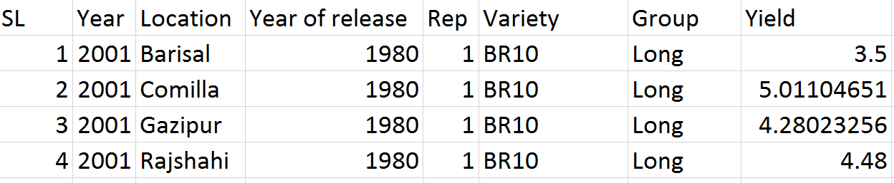
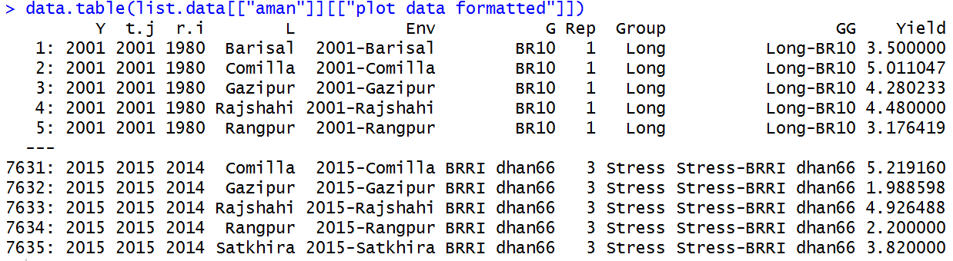
Data
Original
Formatted
Numeric
New columns

Slide 5
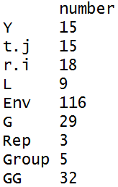
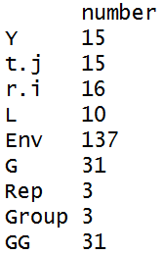
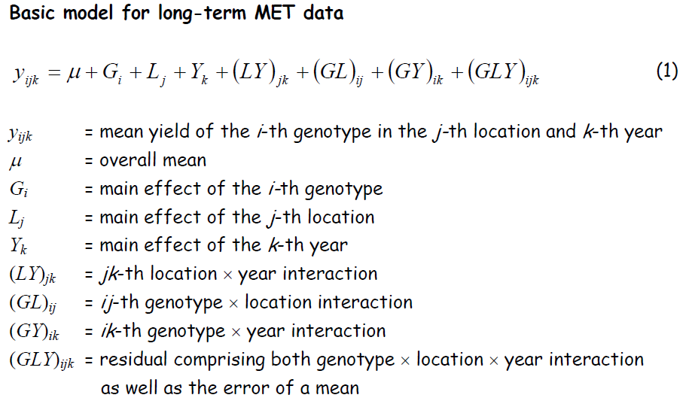
Data
Table: Number of unique entries per column
Aman | Boro

Slide 6
Two datasets
Aman & Boro
→ Get mean yield for each genotype at each environment
GxE means

Slide 7
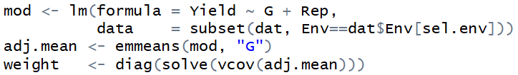
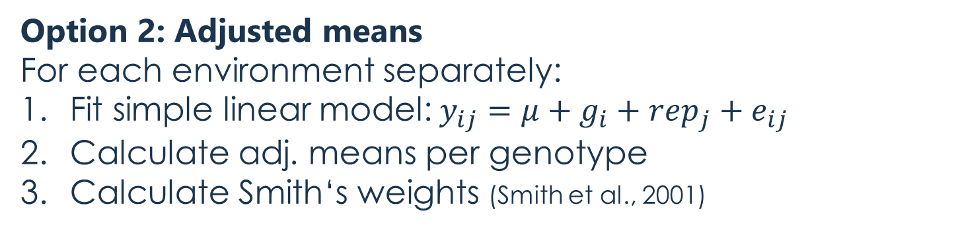
GxE means
Goal: Obtain yield per genotype and environment averaged over replicates
Option 1: Arithmetic means
Option 2: Adjusted means
For each environment separately:
Fit simple linear model:$y_{ij}=μ+g_{i}+rep_{j}+e_{ij}$
Calculate adj. means per genotype
Calculate Smith‘s weights (Smith et al., 2001)

Slide 8
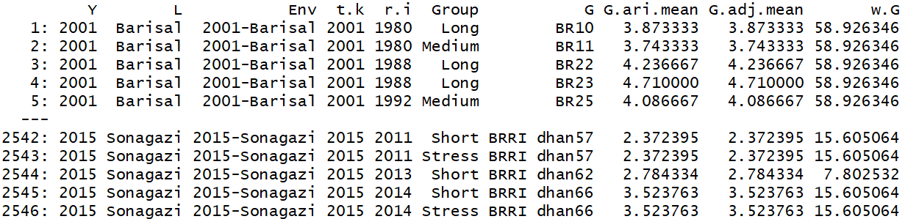
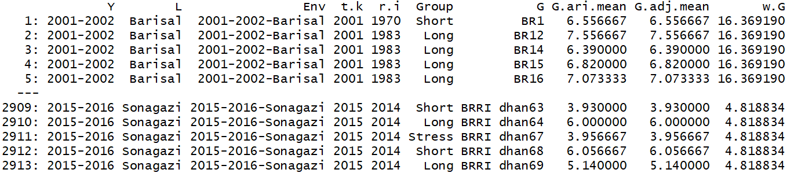
GxE means
Aman
Option 1
Option 2
Boro

Slide 9
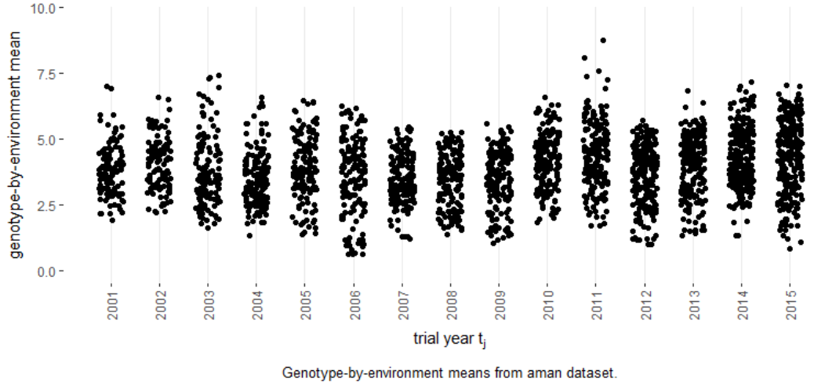

GxE means
$$t_{k}$$

Slide 10
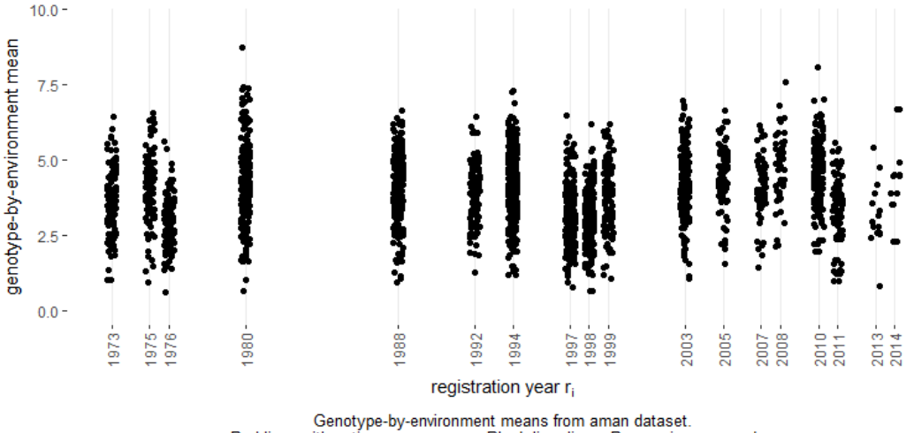
GxE means

Slide 11
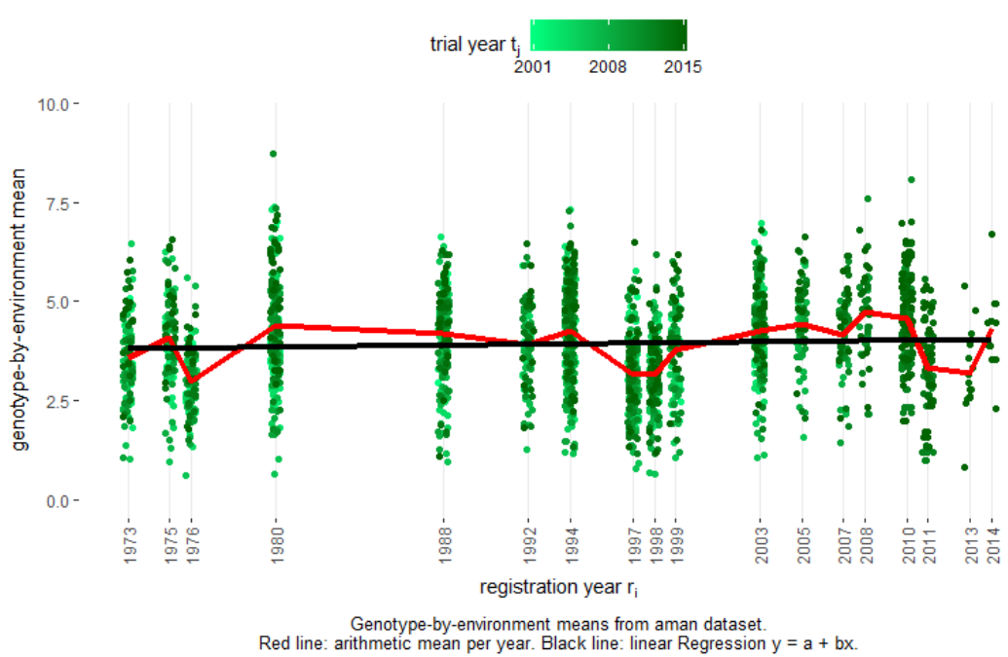

GxE means
$$t_{k}$$

Slide 14
Genetic trend assessment
Incorporating regression terms in basic MET mixed model

Slide 15
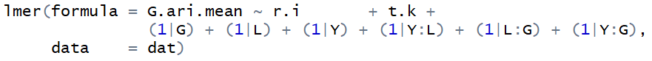
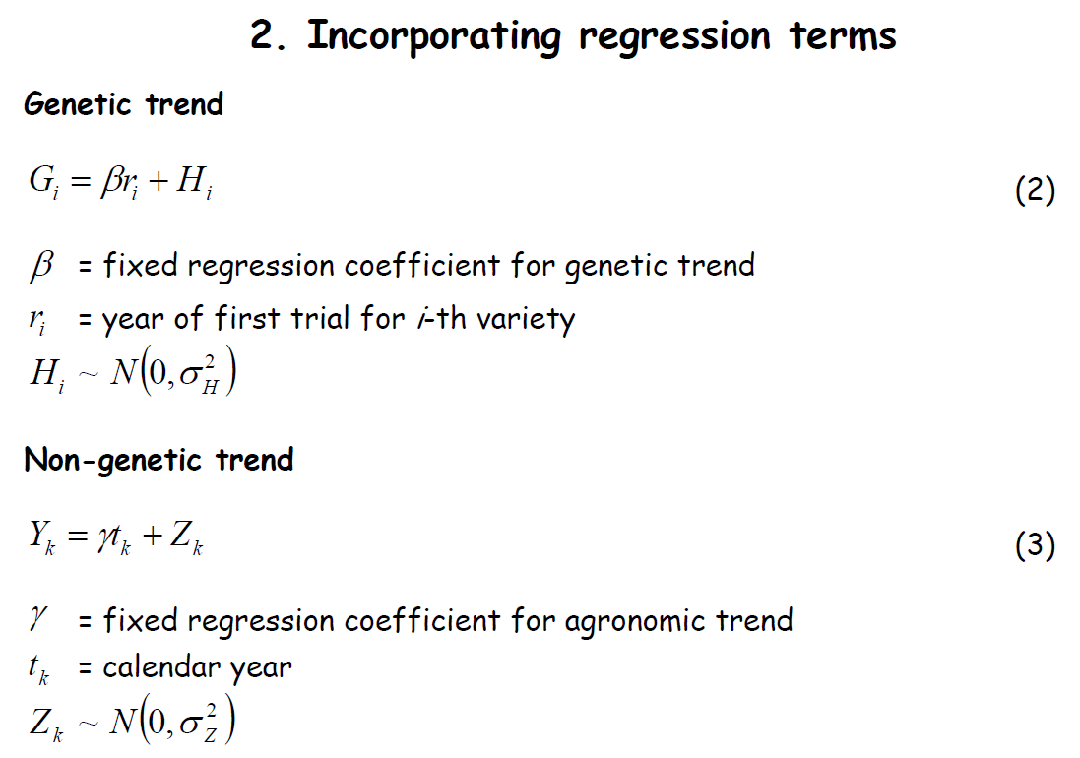
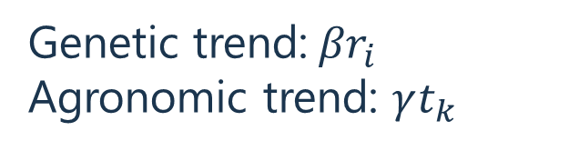
Genetic trend assessment
Genetic trend:${βr}_{i}$
Agronomic trend: $γt_{k}$

Slide 16
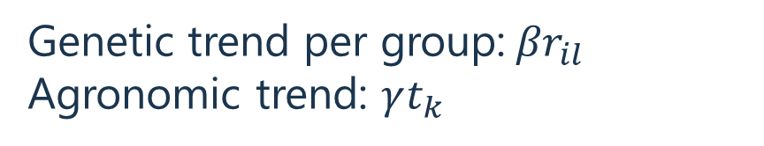
Genetic trend assessment
Genetic trend per group:${βr}_{il}$
Agronomic trend: $γt_{k}$

Slide 17
Summary: Genetic trend assessment
Option 1: Arithmetic means
Dataset | Group | Genetic Trend | Agronomic Trend
aman | Aromatic | 0.0054 (p=0.797)
 | Long | -0.0092 (p=0.641)
 | Medium | 0.0185 (p=0.153) | 0.0195 (p=0.348)
 | Short | 0.0030 (p=0.898)
 | Stress | -0.0661 (p=0.067)
boro | Long | 0.0119 (p=0.012)
 | Short | 0.0104 (p=0.151) | 0.0189 (p=0.451)
 | Stress | 0.0167 (p=0.055)

Slide 18
Summary: Genetic trend assessment
Option 2: Adjusted means with weights
Dataset | Group | Genetic Trend | Agronomic Trend
aman | Aromatic | 0.0048 (p=0.753)
 | Long | -0.0010 (p=0.496)
 | Medium | 0.0167 (p=0.092) | 0.0195 (p=0.348)
 | Short | 0.0013 (p=0.480)
 | Stress | -0.0513 (p=0.075)
boro | Long | 0.0158 (p=0.004)
 | Short | 0.0122 (p=0.165) | 0.0149 (p=0.543)
 | Stress | 0.0197 (p=0.048)

